Slide 1
Travel information advisor
Data Structure Course

Slide 2
Problem introduction
The design of this course requires the design and implementation of a program that provides travel information to users with different preferences, including the following needs: minimum travel time; Minimal travel costs; Minimal number of transfers. We can abstract the correlation between the distance data into a data structure diagram, and then use the Dijkstra algorithm to calculate the optimal path for each case. Then, the express generator framework in the node.js supplements the relevant front-end code and back-end code to realize the interaction between GUI and input and output.

Slide 3
01
Data Structure Definition
02
Algorithms,Key Technologies
03
The Results Displayed
04
Complexity of the Algorithm

Slide 4
01
Data Structure Definition

Slide 5
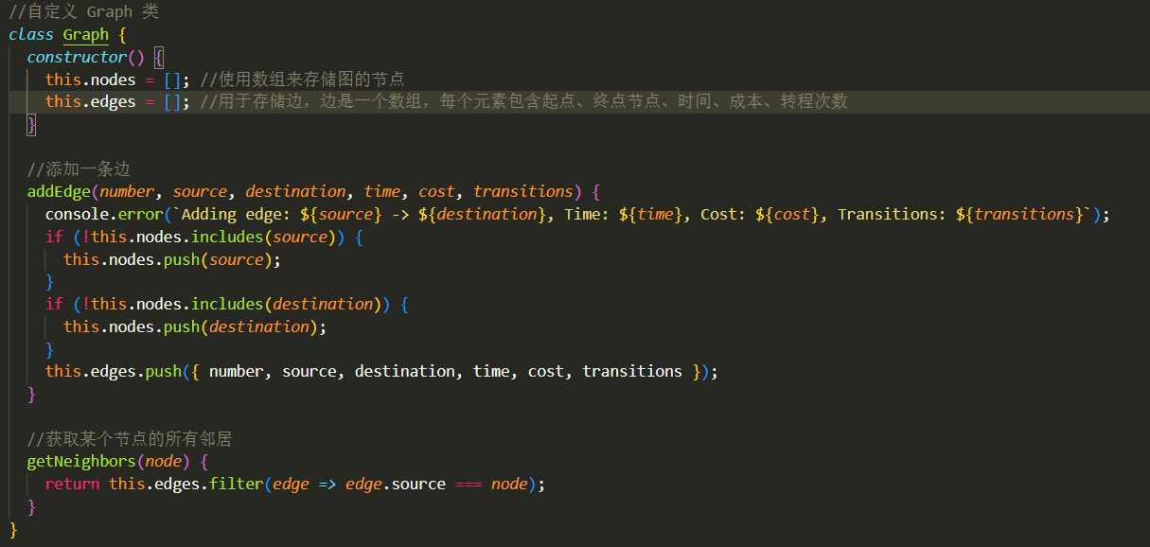

Slide 6


Slide 7
02
Algorithms,Key Technologies

Slide 8
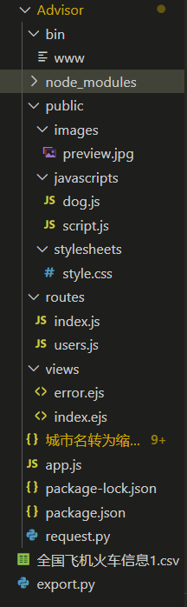
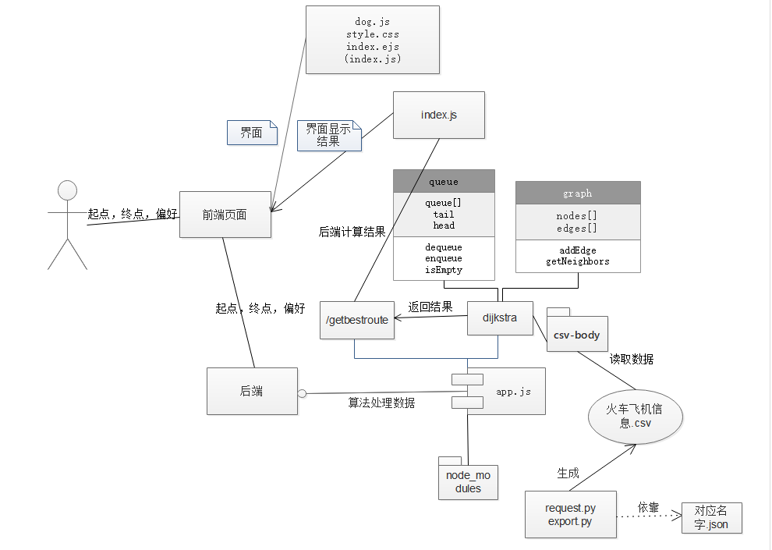

Slide 9

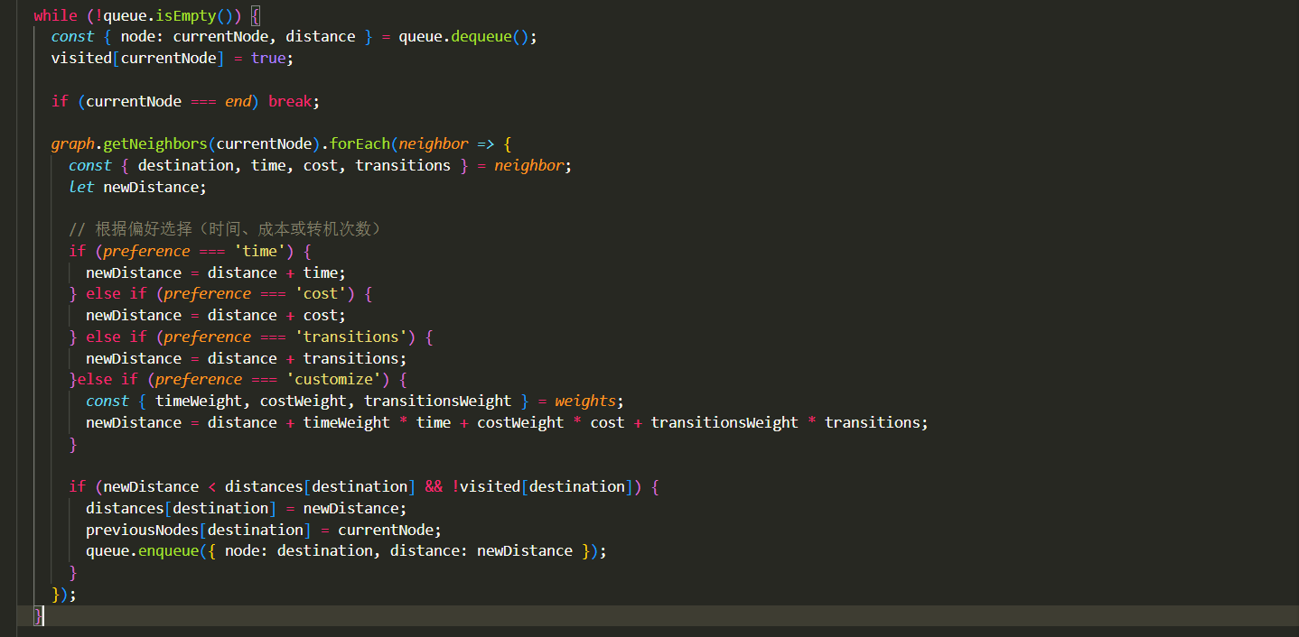
Dijkstra

Slide 10
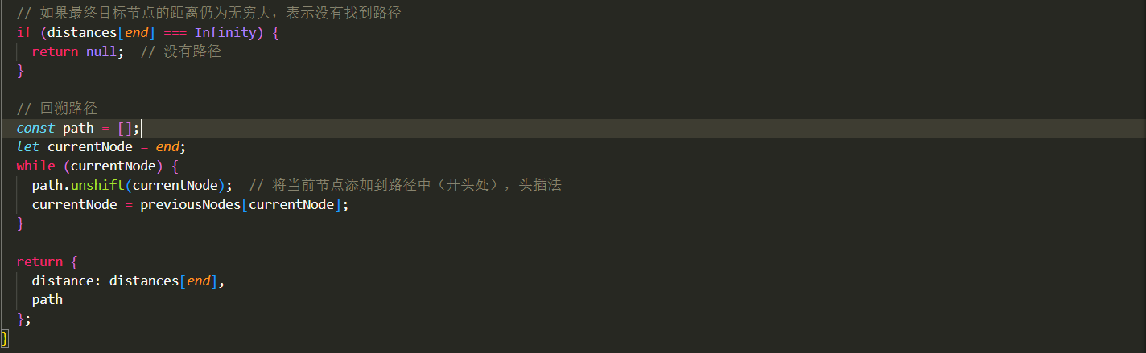
Dijkstra

Slide 11
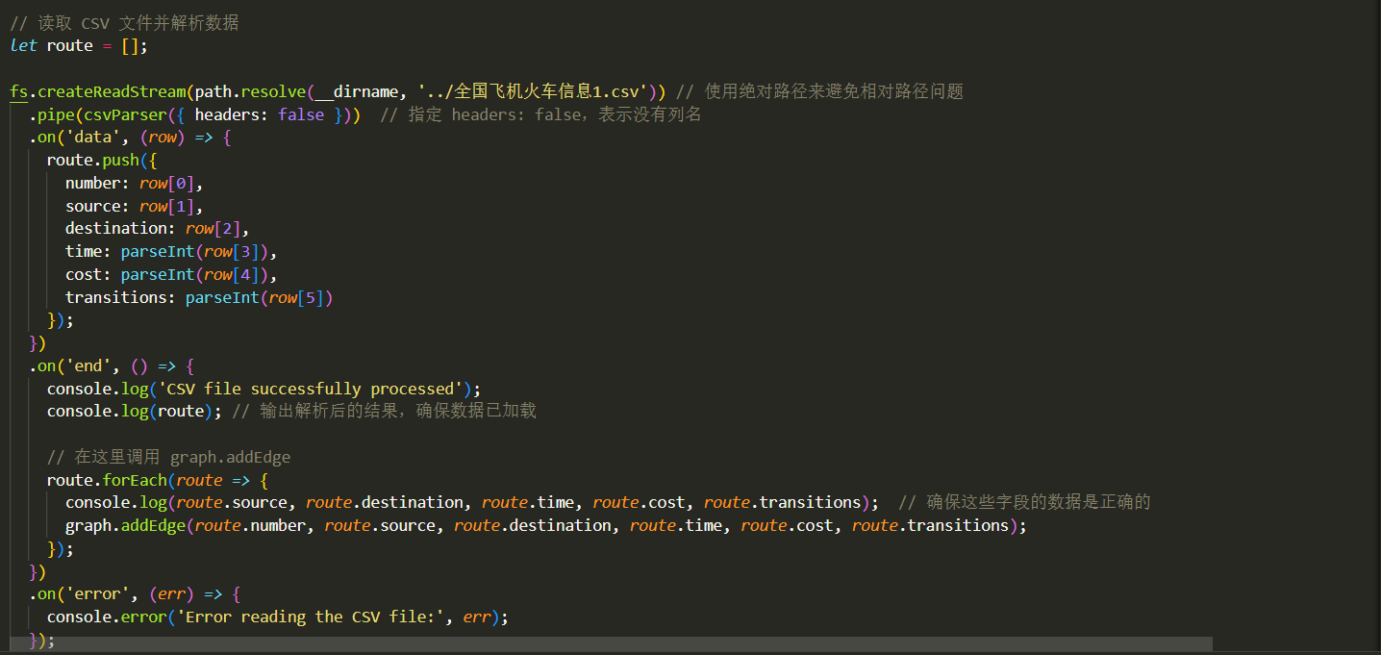
ROUTE(crawler)

Slide 12
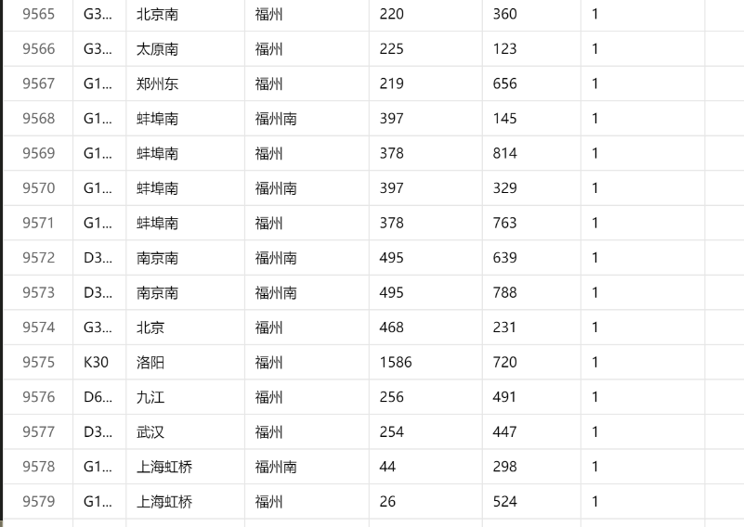

ROUTE(crawler)

Slide 13
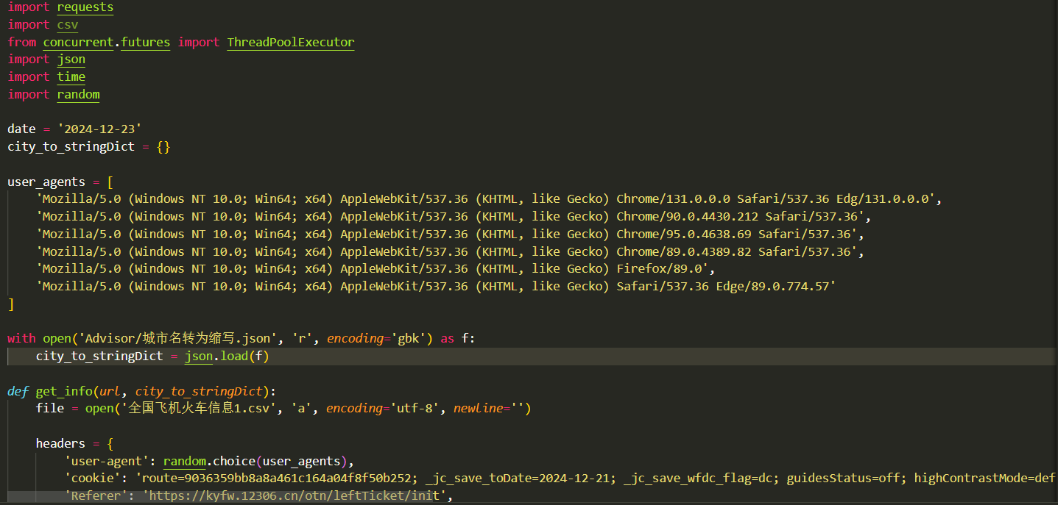
ROUTE(crawler)

Slide 14
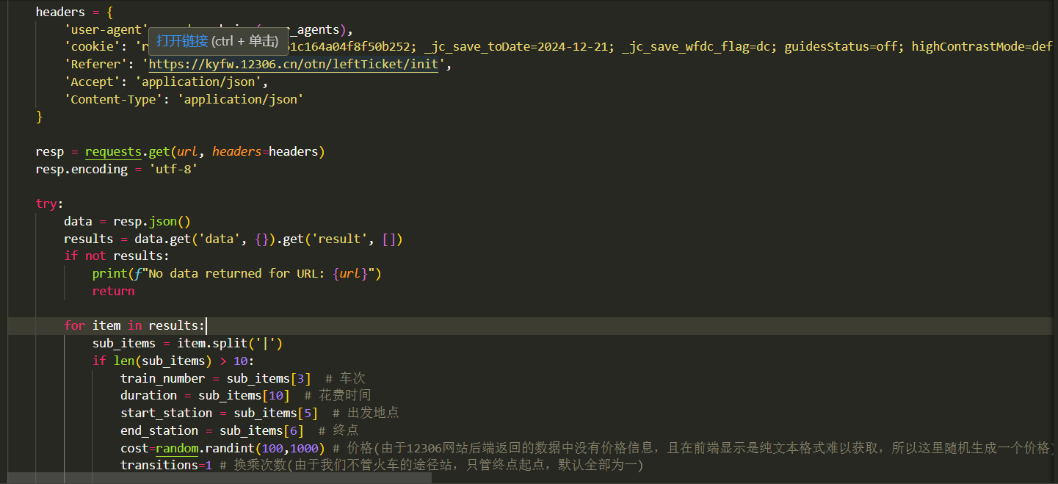
ROUTE(crawler)

Slide 15
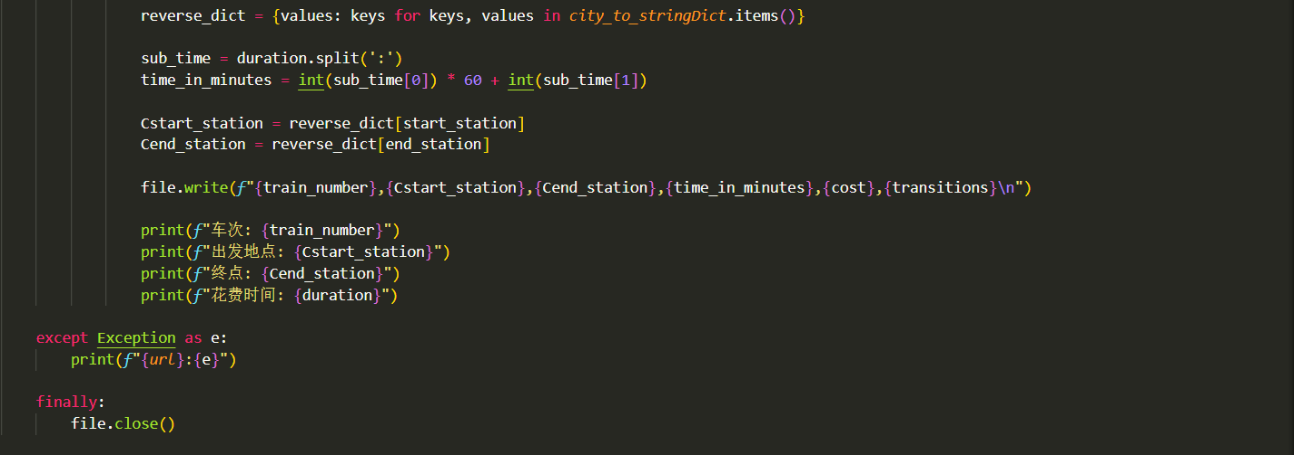
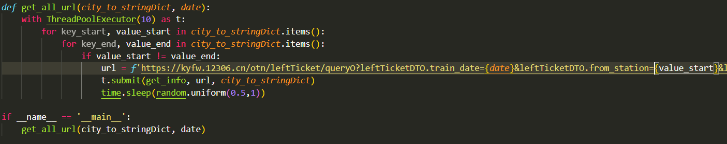
ROUTE(crawler)

Slide 16
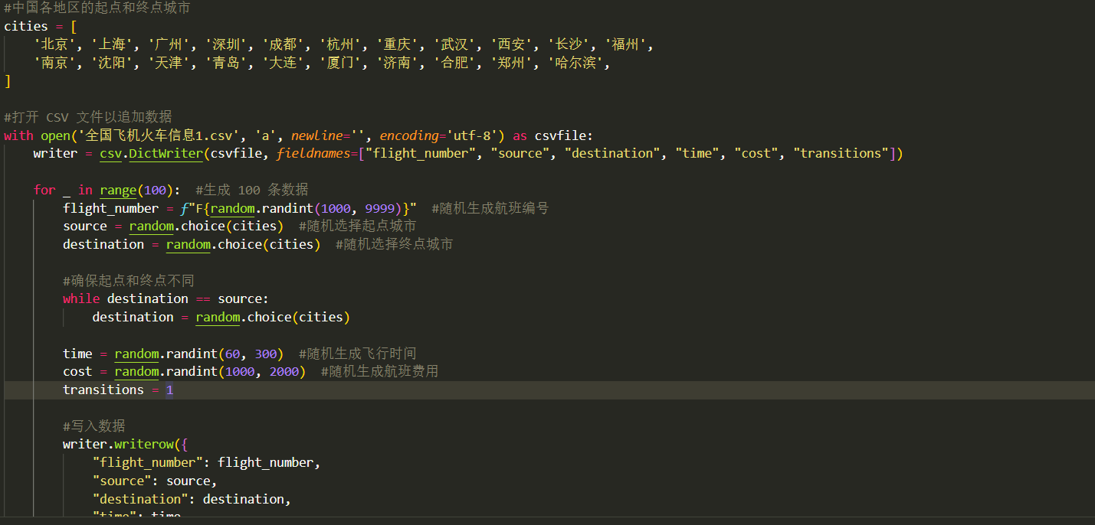
ROUTE(crawler)

Slide 17
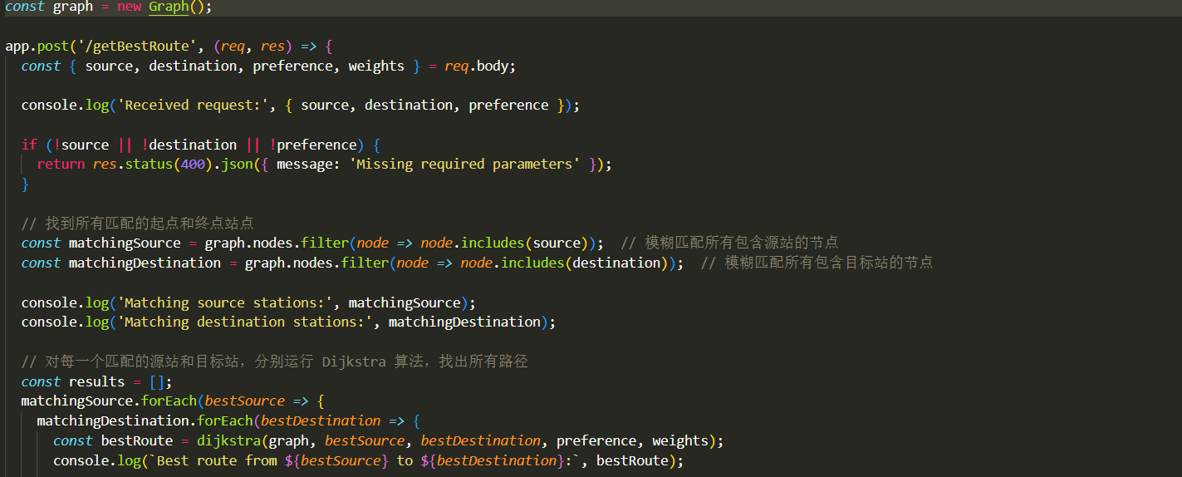
Get the best path backend

Slide 18
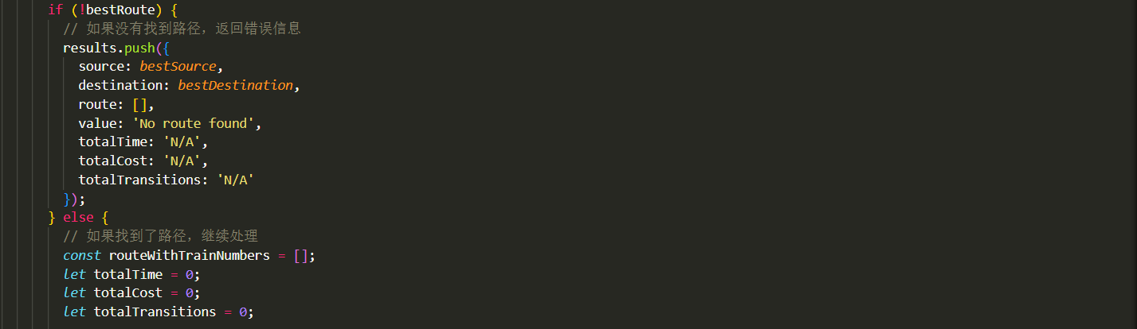
Get the best path backend

Slide 19
Get the best path backend

Slide 20
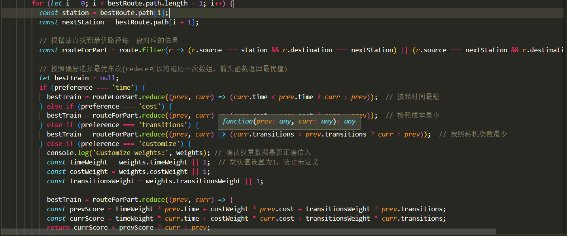
Get the best path backend

Slide 21
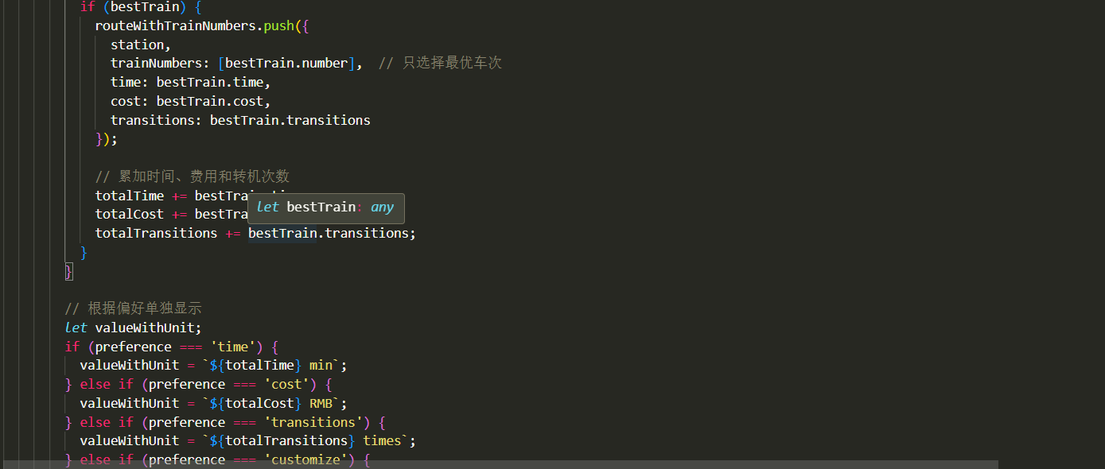
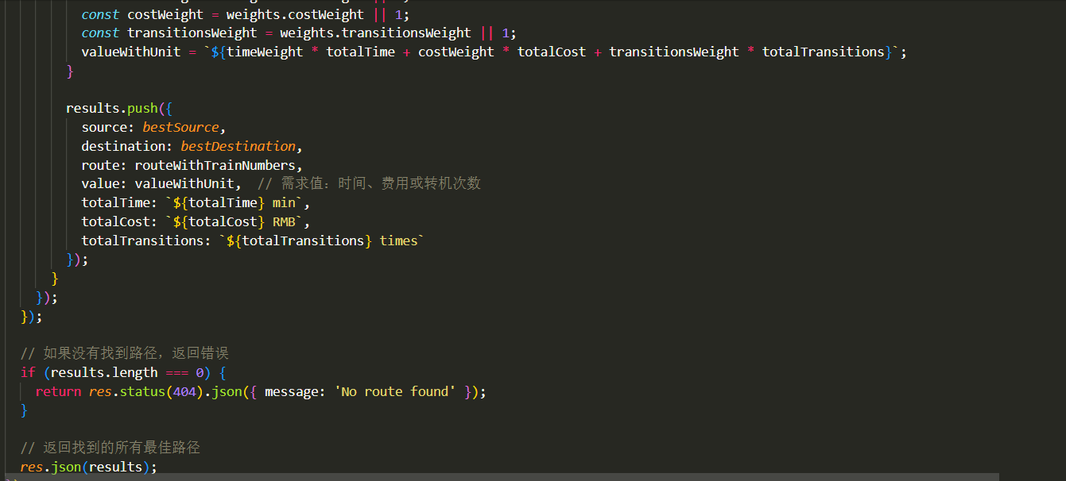

Slide 22
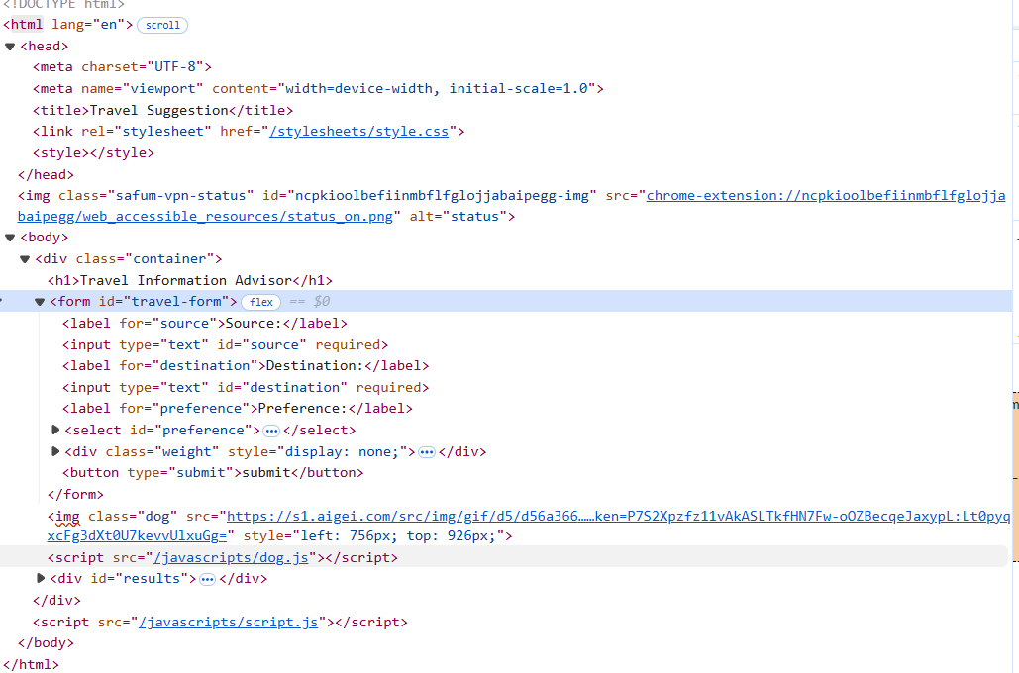
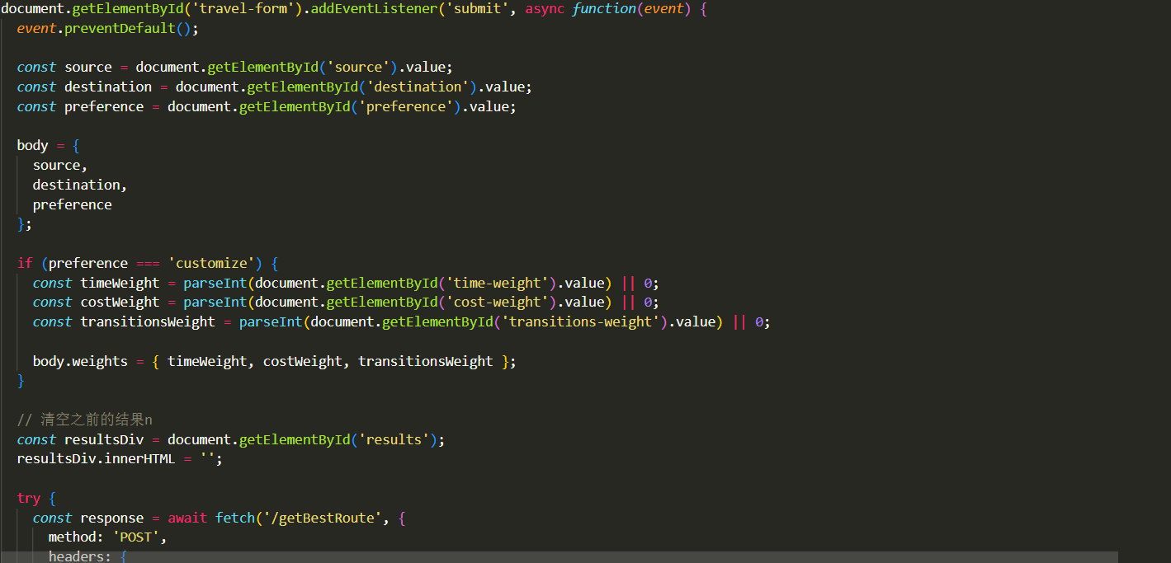
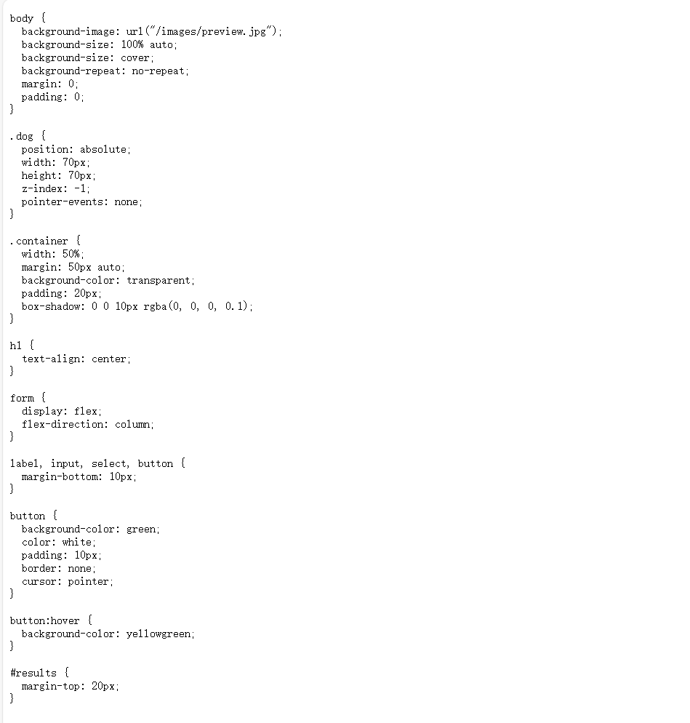

DOM
PAGE

Slide 23
03
The Results Displayed

Slide 24


Slide 25


Slide 26


Slide 27


Slide 28
04
Complexity of the Algorithm

Slide 29
Complexity of the Algorithm
Dijkstra algorithm, the time complexity of which depends on how the queue is implemented. Simple queue , the queuing operation needs to traverse the queue to find the node with the smallest current distance, the complexity is O(N), and the time complexity of the overall main loop is O(N2+E)

Slide 30
THANKS FOR LISTENING

